Slide 1
Self-Attention & Transformers
Plaban Kumar Bhowmick
Department of AI
plaban@ai.iitkgp.ac.in

Slide 2
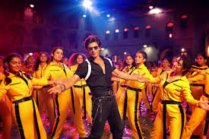
Attention Please!!
नाम तो सुना ही होगा
Attention may be universal

Slide 3
Attention All You Need!!
Attention may be “contextual”

Slide 4
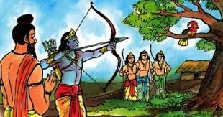
Attention All You Need!!
What do you see?
Attention may be task dependant

Slide 5
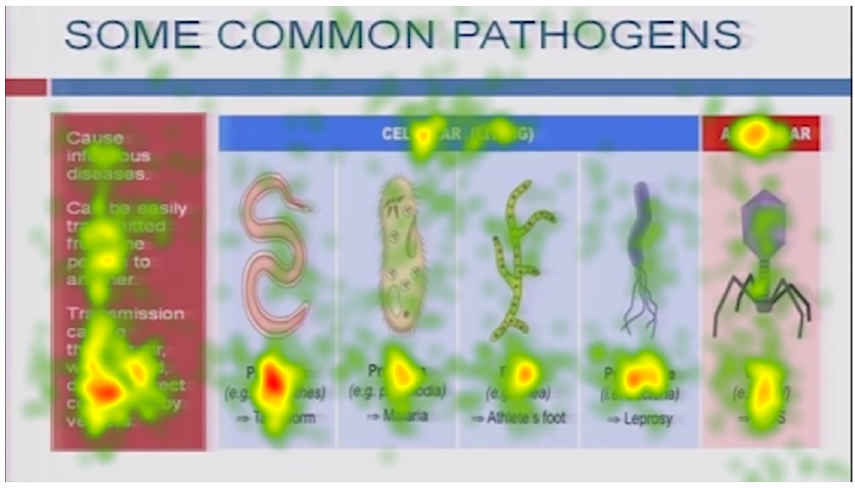
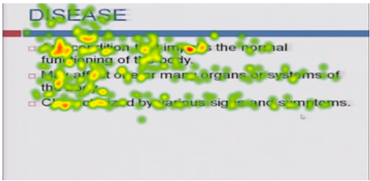
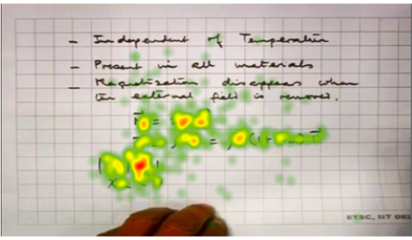
Attention All You Need!!
Good visual + Good Audio
Can we implement attentive behavior of human
in AI models?
Bad visual + Bad Audio

Slide 6
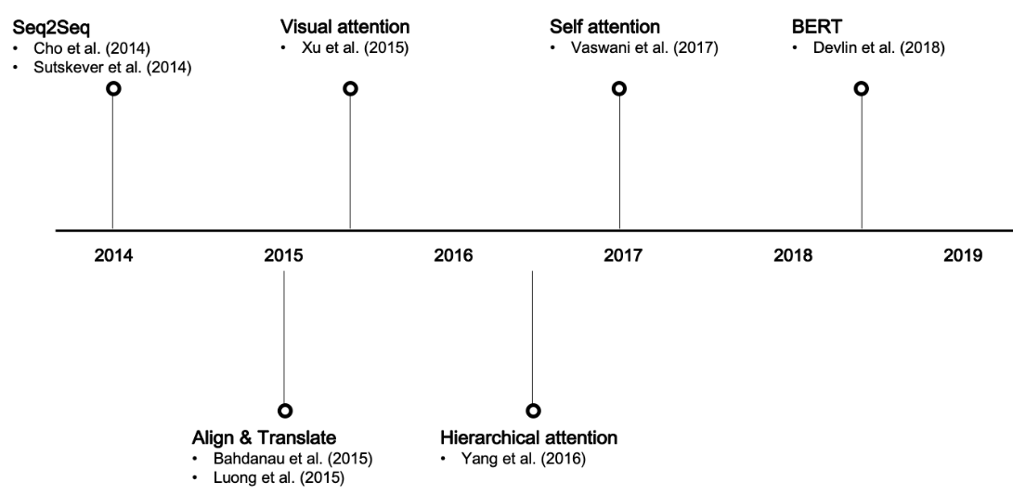
Key Developments in Attention

Slide 7
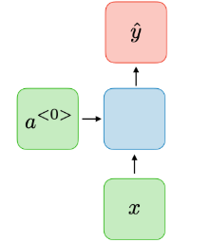
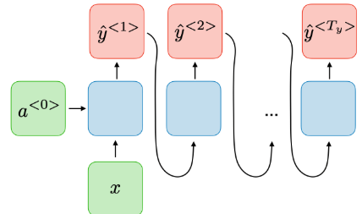
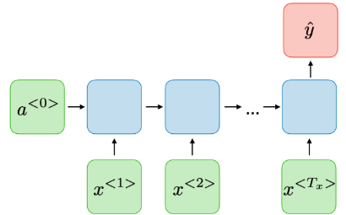
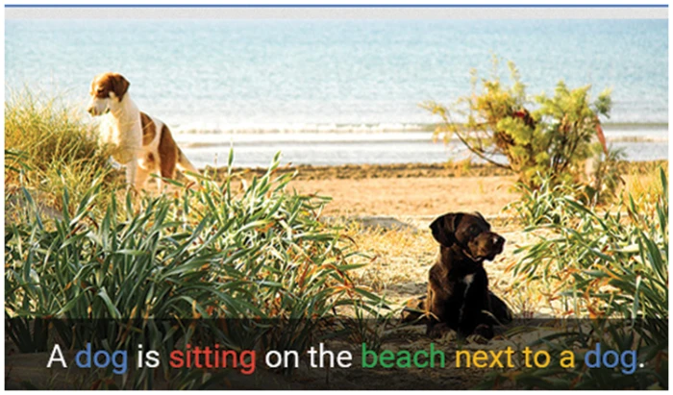
RNN Type & NLP Tasks
One-to-One
One-to-Many
Many-to-One
Network without Time
Image Captioning
Sentiment Classification
Never a dull moment, The Colors are so vivid they'll stain your TV screen.

Slide 8
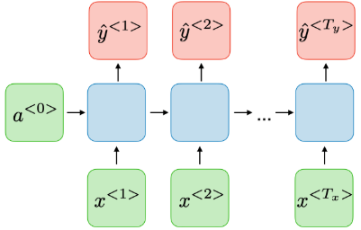
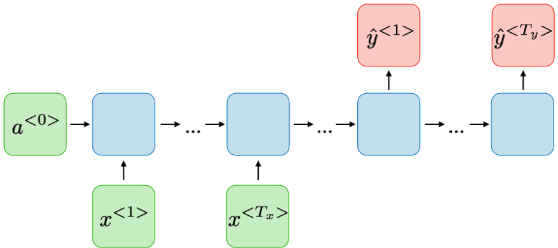
RNN Type & NLP Tasks
Many-to-Many
Many-to-Many
Named Entity Recognition
Machine Translation
Sunshine on my shoulders makes me happy
Bill Gates and Paul Allen founded Microsoft
मेरे कंधों पर धूप मुझे खुश कर देती है

Slide 9
Sequence to Sequence Task with RNN
Decoder: $s_{t}=g_{U}(y_{t−1},s_{t−1},c)$
Decoder: $s_{1}=g_{U}(y_{0},s_{0},c)$
Output: ${\tilde{y}}_{t}={softmax(l}_{V}(s_{t}))$
Input Sequence: $x_{1}, x_{2}, …, x_{T}$
Output Sequence:$y_{1}, y_{2}, …, y_{T^{′}}$
मैं
आपको
देख
सकता
हूं
<EOS>
$${\tilde{y}}_{1}$$
$${\tilde{y}}_{2}$$
$${\tilde{y}}_{3}$$
$${\tilde{y}}_{4}$$
$${\tilde{y}}_{5}$$
$${\tilde{y}}_{6}$$
Encoder:$h_{t}=f_{W}(x_{t},h_{t−1})$
$$h_{2}=f_{W}(x_{2},h_{1})$$
Initial decoder state $s_{0}$
$$h_{1}$$
$$h_{2}$$
$$h_{3}$$
$$h_{4}$$
$$s_{0}$$
$$s_{1}$$
$$s_{2}$$
$$s_{3}$$
$$s_{4}$$
$$s_{5}$$
$$s_{6}$$
$$c$$
$$x_{1}$$
$$x_{2}$$
$$x_{3}$$
$$x_{4}$$
Context vector $c$
Often $c=h_{T}$
$$y_{0}$$
$$y_{1}$$
$$y_{2}$$
$$y_{3}$$
$$y_{4}$$
$$y_{5}$$
I
can
see
you
<START>
मैं
आपको
देख
सकता
हूं

Slide 10
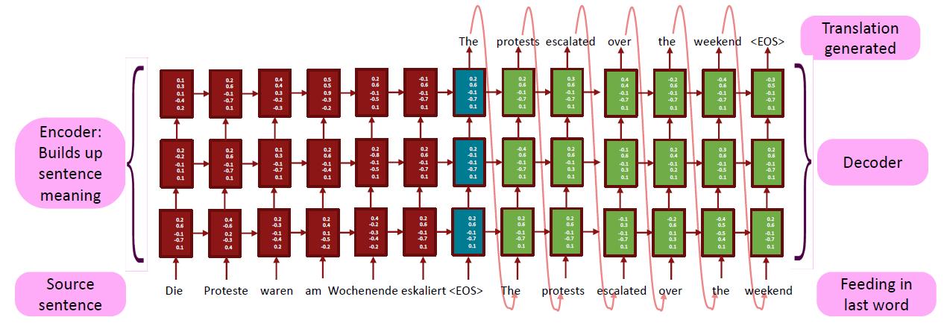
Multi-layer Deep RNN

Slide 11
Some Issues Vanilla RNN
Long Distance Dependency:
The letter that Juliet dreamt of carrying the fragrance of boundless love and soothing ray of hope has
never been delivered.
$$h_{1}$$
$$h_{2}$$
$$h_{3}$$
$$h_{4}$$
$$s_{0}$$
Problem: Input sequence bottlenecks through fixed sized c. What if T=1000?
$$c$$
$$x_{1}$$
$$x_{2}$$
$$x_{3}$$
$$x_{100}$$
Multiple Activations:
Roger Federer is serving for the match.
रोजर फेडरर मैच के लिए सर्विस कर रहे हैं।
Roger Federer is serving food to her wife.
रोजर फेडरर अपनी पत्नी को खाना परोस रहे हैं।

Slide 12
Some Issues Vanilla RNN
Long Distance Dependency:
The letter that Juliet dreamt of carrying the fragrance of boundless love and soothing ray of hope has
never been delivered.
$$h_{1}$$
$$h_{2}$$
$$h_{3}$$
$$h_{4}$$
$$s_{0}$$
Solution: Look back at the whole input sequence on each step of the output
$$c$$
$$x_{1}$$
$$x_{2}$$
$$x_{3}$$
$$x_{100}$$
Multiple Activations:
Roger Federer is serving for the match.
रोजर फेडरर मैच के लिए सर्विस कर रहे हैं।
Roger Federer is serving food to her wife.
रोजर फेडरर अपनी पत्नी को खाना परोस रहे हैं।

Slide 13
Seq2Seq RNN and Attention
0.03
0.05
0.7
0.01
0.01
0.2
Roger Feder is serving for the match.
रोजर फेडरर मैच के लिए सर्विस कर रहे हैं।
$$α_{1}$$
$$α_{2}$$
$$α_{3}$$
$$α_{4}$$
$$c$$
$$h_{1}$$
$$h_{2}$$
$$h_{3}$$
$$h_{4}$$
But how to tune the $α_{i}$’s?
Should not be hardcoded
Let us make them trainable
$$x_{1}$$
$$x_{2}$$
$$x_{3}$$
$$x_{4}$$
I
can
see
you

Slide 14
Seq2Seq RNN and Attention
What do the $α_{i}$’s depend on?
How similar an encoder state $h_{i}$ is with the current decoder state ($s_{t}$)
$α_{i}$ → $α_{ti}$
(similarity of $h_{i}$ and $s_{t}$)
Compute alignment scores ($e_{ti}$)
$$e_{ti}=f_{ATT}(s_{t−1}, h_{i})$$
$$α_{01}$$
$$α_{02}$$
$$α_{03}$$
$$α_{04}$$
Softmax Normalization ($α_{ti}$)
SOFTMAX
$$α_{ti}=\frac{exp⁡(e_{ti})}{\sum_{k=1}^{T}{exp⁡(e_{tk})}}$$
$${\tilde{y}}_{1}$$
$$e_{01}$$
$$e_{02}$$
$$e_{03}$$
$$e_{04}$$
Context Vector ($c_{t}$)
$$c_{t}=\sum_{i=1}^{T}{α_{ti}h_{i}}$$
$$h_{1}$$
$$h_{2}$$
$$h_{3}$$
$$h_{4}$$
$$s_{0}$$
$$s_{1}$$
Decoder State ($s_{t}$)
$$x_{1}$$
$$x_{2}$$
$$x_{3}$$
$$x_{4}$$
$$c_{1}$$
$$y_{0}$$
$$s_{t}=g_{U}(y_{t−1},s_{t−1},c_{t})$$
I
can
see
you

Slide 15
Seq2Seq RNN and Attention
What do the $α_{i}$’s depend on?
How similar an encoder state $h_{i}$ is with the current decoder state ($s_{t}$)
$α_{i}$ → $α_{ti}$
(similarity of $h_{i}$ and $s_{t}$)
Use a different context vector in each timestep of decoder
$$α_{11}$$
$$α_{12}$$
$$α_{13}$$
$$α_{14}$$
SOFTMAX
$${\tilde{y}}_{1}$$
$${\tilde{y}}_{2}$$
Input sequence not bottlenecked through single vector
At each timestep of decoder, context vector “looks at” different parts of the input sequence
$$e_{11}$$
$$e_{12}$$
$$e_{13}$$
$$e_{14}$$
$$h_{1}$$
$$h_{2}$$
$$h_{3}$$
$$h_{4}$$
$$s_{0}$$
$$s_{1}$$
$$s_{2}$$
$$x_{1}$$
$$x_{2}$$
$$x_{3}$$
$$x_{4}$$
$$c_{1}$$
$$y_{0}$$
$$c_{2}$$
$$y_{1}$$
I
can
see
you

Slide 16
Visualization of Attention in MT

Slide 17
Seq2Seq RNN and Attention
Data vector (Encoder state)
Query vector (Decoder state)
Output vector (Context state)
Each query attends to all data vectors and gives one output vector
$${\tilde{y}}_{1}$$
$${\tilde{y}}_{2}$$
$${\tilde{y}}_{3}$$
$${\tilde{y}}_{4}$$
$$h_{1}$$
$$h_{2}$$
$$h_{3}$$
$$h_{4}$$
$$s_{0}$$
$$s_{1}$$
$$s_{2}$$
$$s_{3}$$
$$s_{4}$$
$$x_{1}$$
$$x_{2}$$
$$x_{3}$$
$$x_{4}$$
$$c_{1}$$
$$y_{0}$$
$$c_{2}$$
$$y_{1}$$
$$c_{3}$$
$$y_{2}$$
$$c_{4}$$
$$y_{3}$$
I
can
see
you

Slide 18
An Attention Layer
Inputs:
Query vector: $q[D_{q}]$
Data vectors: $H[T×D_{h}]$
$$α_{01}$$
$$α_{02}$$
$$α_{03}$$
$$α_{04}$$
Computation:
SOFTMAX
Alignment Score: $e\left[T\right]{ e}_{i}=f_{ATT}(q,H_{i})$
$$e_{01}$$
$$e_{02}$$
$$e_{03}$$
$$e_{04}$$
Attention Weight: $α\left[T\right]{ α}_{i}=Softmax(e)$
$$h_{1}$$
$$h_{2}$$
$$h_{3}$$
$$h_{4}$$
$$s_{0}$$
Output Vector: $c\left[D_{h}\right] c=\sum_{i}{α_{i}H_{i}}$
$$x_{1}$$
$$x_{2}$$
$$x_{3}$$
$$x_{4}$$
$$c_{1}$$
I
can
see
you

Slide 19
An Attention Layer (Matrix Implementation)
Inputs:
Query vector: $Q[T^{′}×D_{h}]$
Data vectors: $H[T×D_{h}]$
$$α_{01}$$
$$α_{02}$$
$$α_{03}$$
$$α_{04}$$
Computation:
Alignment Score: $E\left[T^{′}×T\right]$
$E={QH^{⊤}}/{\sqrt{D_{h}}}$
SOFTMAX
$$e_{01}$$
$$e_{02}$$
$$e_{03}$$
$$e_{04}$$
Scaled dot product to
stabilize gradient
$i$→ query index
$$E_{ij}={Q_{i}H_{j}^{⊤}}/{\sqrt{D_{h}}}$$
$j$→ data index
$$h_{1}$$
$$h_{2}$$
$$h_{3}$$
$$h_{4}$$
$$s_{0}$$
Attention Weight: $Α\left[T^{′}×T\right]$
$$A=Softmax(E, dim=1)$$
$$x_{1}$$
$$x_{2}$$
$$x_{3}$$
$$x_{4}$$
$$c_{1}$$
Output Vector: $C\left[T^{′}×D_{h}\right]$
$C=AH$
I
can
see
you

Slide 20
An Attention Layer (Query-Key-Value)
Inputs:
Query vector: $Q[T^{′}×D_{q}]$
Data vectors: $H[T×D_{h}]$
Key matrix: $W_{K}[D_{h}×D_{q}]$
$$α_{01}$$
$$α_{02}$$
$$α_{03}$$
$$α_{04}$$
Value matrix: $W_{V}[D_{h}×D_{v}]$
SOFTMAX
Computation:
$$e_{01}$$
$$e_{02}$$
$$e_{03}$$
$$e_{04}$$
Keys: $K=HW_{K} [T×D_{q}]$
Values: $V=HW_{V}[T×D_{v}]$
$$h_{1}$$
$$h_{2}$$
$$h_{3}$$
$$h_{4}$$
$$s_{0}$$
Alignment Score: $E=QK^{⊤}/\sqrt{D_{q}}\left[T^{′}×T\right]$
Attention Weight: $A\left[T^{′}×T\right]$
$$A=Softmax(E, dim=row)$$
$$x_{1}$$
$$x_{2}$$
$$x_{3}$$
$$x_{4}$$
$$c_{1}$$
Output Vector: $C\left[T^{′}×D_{v}\right]$
$C=AV$
I
can
see
you

Slide 21
An Attention Layer (Query-Key-Value)
$$C_{1}$$
$$C_{2}$$
$$C_{3}$$
$$C_{4}$$
Inputs:
PRODUCT ( ) SUM ( )
Query vector: $Q[T^{′}×D_{q}]$
Data vectors: $H[T×D_{h}]$
$$V_{1}$$
$$A_{11}$$
$$A_{21}$$
$$A_{31}$$
$$A_{41}$$
Key matrix: $W_{K}[D_{h}×D_{q}]$
$$V_{2}$$
$$A_{12}$$
$$A_{22}$$
$$A_{32}$$
$$A_{42}$$
Value matrix: $W_{V}[D_{h}×D_{v}]$
$$V_{3}$$
$$A_{13}$$
$$A_{23}$$
$$A_{33}$$
$$A_{43}$$
Computation:
$$W_{V}$$
Keys: $K=HW_{K} [T×D_{q}]$
SOFTMAX
Values: $V=HW_{V}[T×D_{v}]$
$$H_{1}$$
$$K_{1}$$
$$E_{11}$$
$$E_{21}$$
$$E_{31}$$
$$E_{41}$$
Alignment Score: $E=QK^{⊤}/\sqrt{D_{q}}\left[T^{′}×T\right]$
$$H_{2}$$
$$K_{2}$$
$$E_{12}$$
$$E_{22}$$
$$E_{32}$$
$$E_{42}$$
Attention Weight: $A\left[T^{′}×T\right]$
$$A=Softmax(E, dim=row)$$
$$H_{3}$$
$$K_{3}$$
$$E_{13}$$
$$E_{23}$$
$$E_{33}$$
$$E_{43}$$
Output Vector: $C\left[T^{′}×D_{v}\right]$
$C=AV$
$$W_{K}$$
$$Q_{1}$$
$$Q_{2}$$
$$Q_{3}$$
$$Q_{4}$$
**The visualization actually uses $E^{⊤}$

Slide 22
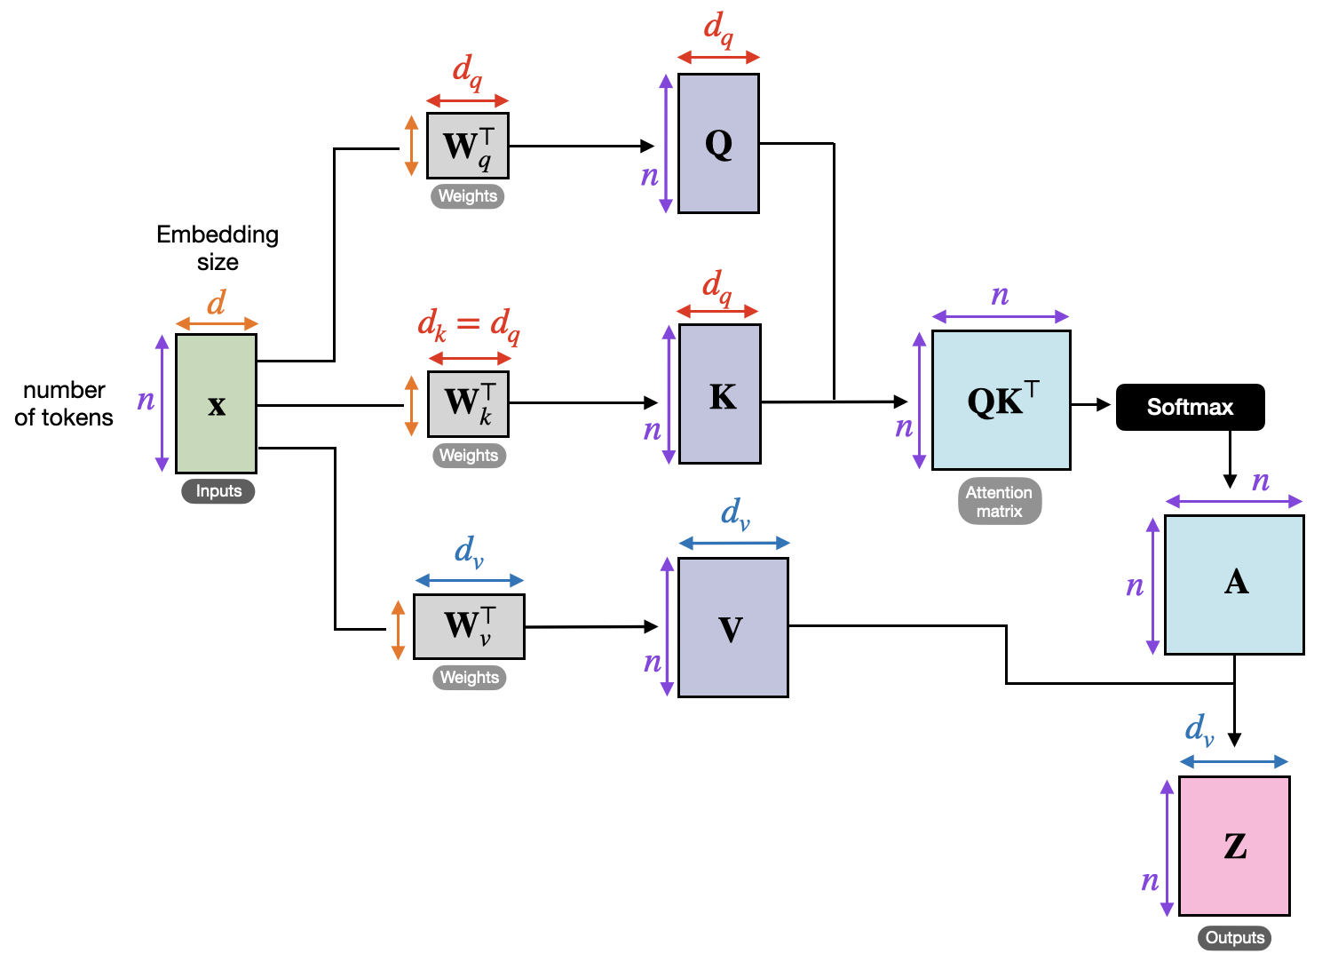
Types of Attention Layers (Self Attention)
Applied between the
encoder states ($h_{i}$’s)
Applied between the
decoder states ($s_{t}$’s)
But not between $h_{i}$and $s_{t}$

Slide 23
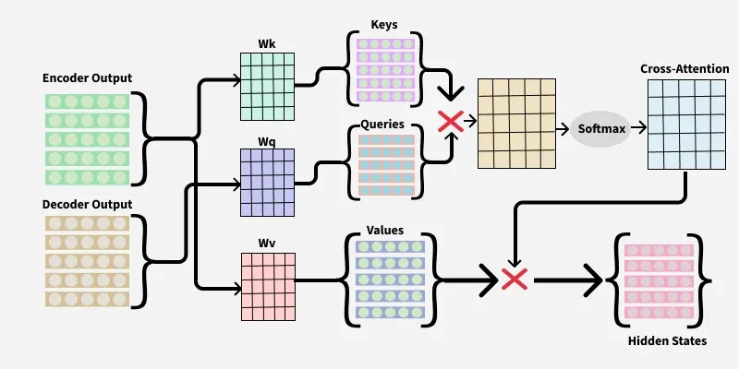
Types of Attention Layers (Cross Attention)

Slide 24
Types of Attention Layers (Masked Attention)

Slide 25
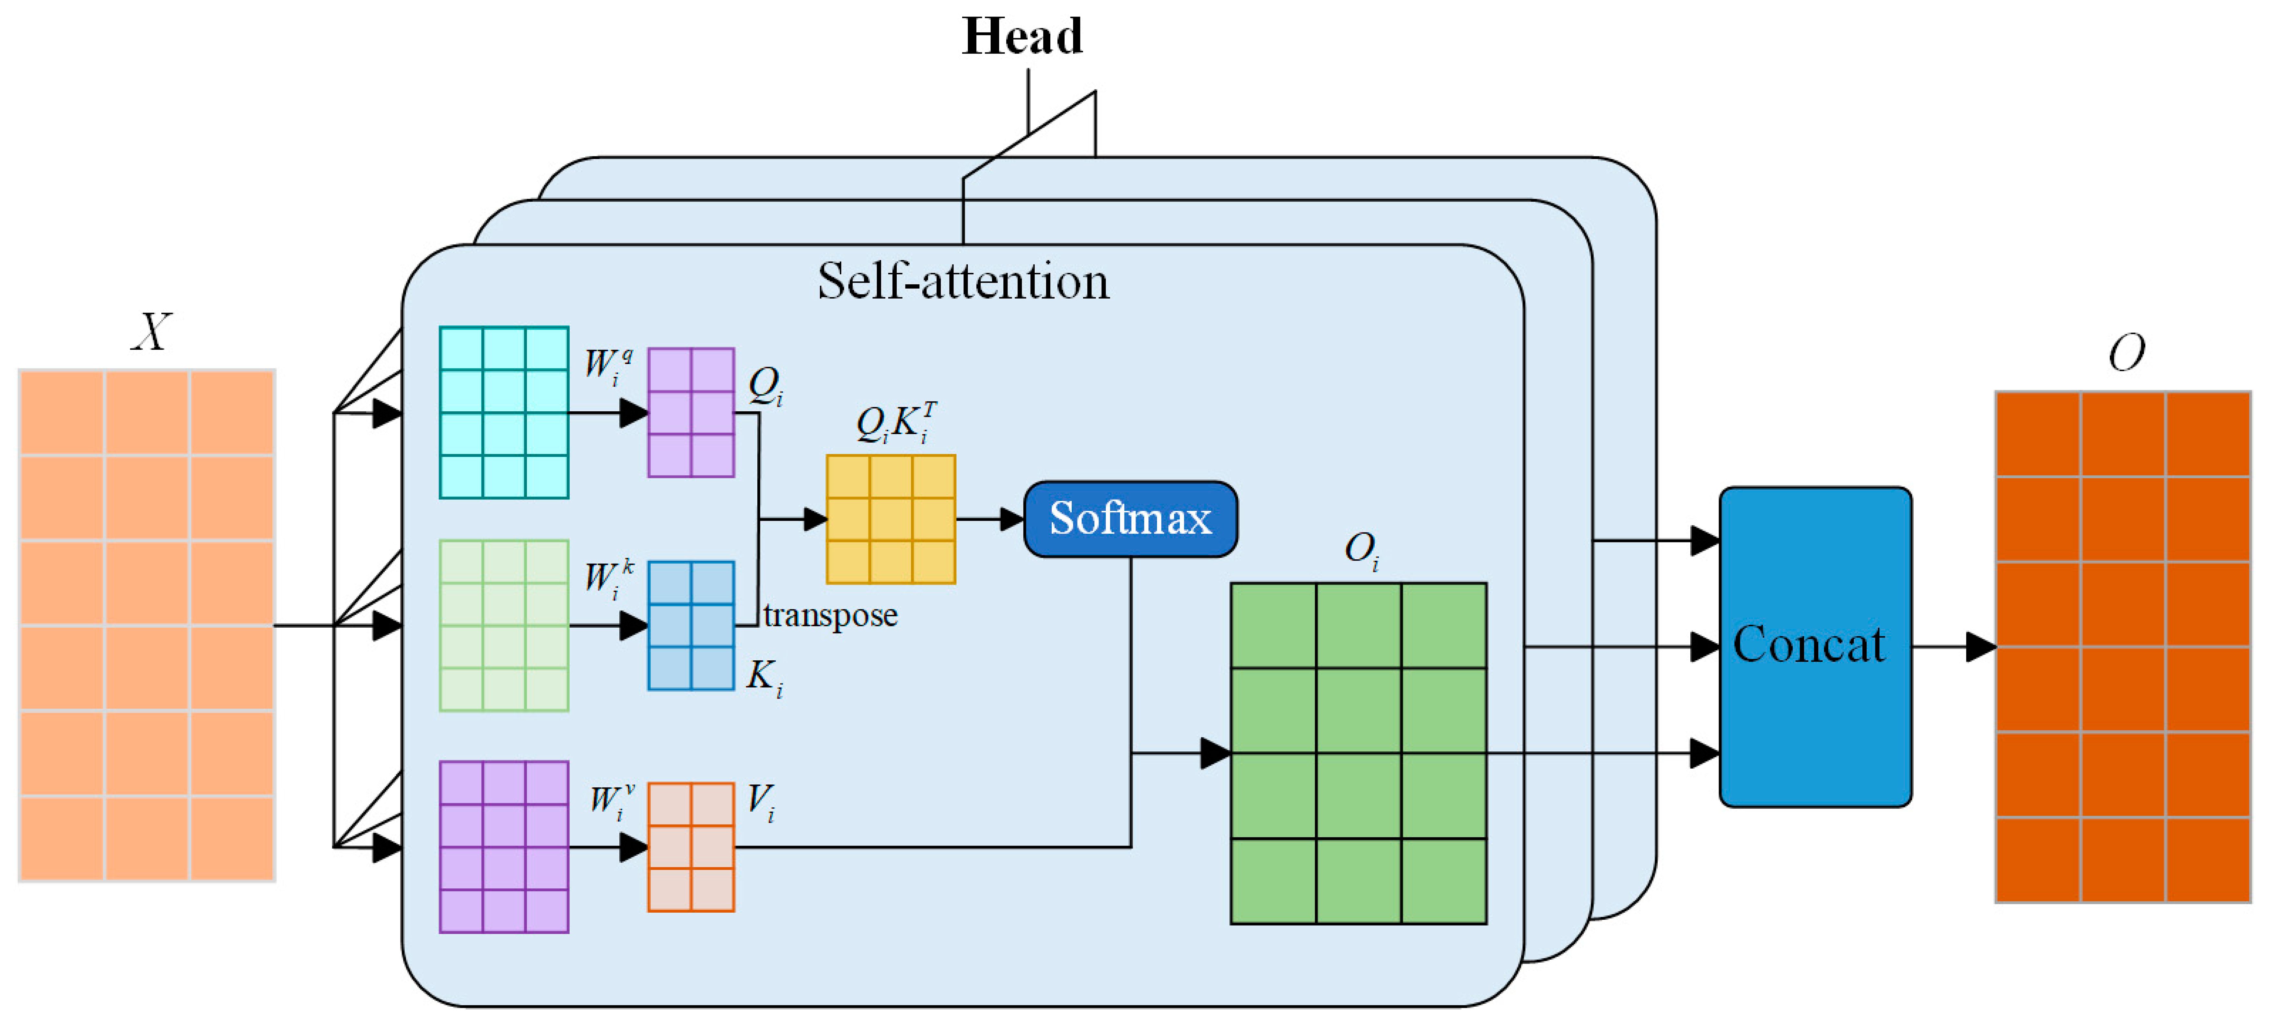
Types of Attention Layers (Multi-head Attention)

Slide 26
An Attention Layer (Implementation)
$$C_{1}$$
$$C_{2}$$
$$C_{3}$$
$$C_{4}$$
sentence = ‘I can see you'
PRODUCT ( ) SUM ( )
dc = {s:i for i,s in enumerate(sorted(sentence.replace(',’, '').split()))}
$$A_{11}$$
$$A_{21}$$
$$A_{31}$$
$$A_{41}$$
$$V_{1}$$
$$V_{2}$$
$$A_{12}$$
$$A_{22}$$
$$A_{32}$$
$$A_{42}$$
{‘see': 0, ‘you': 1, ‘can': 2, ‘I': 3}
$$V_{3}$$
$$A_{13}$$
$$A_{23}$$
$$A_{33}$$
$$A_{43}$$
sentence_int = torch.tensor([dc[s] for s in sentence.replace(',’, '').split()])
$$W_{V}$$
SOFTMAX
tensor([3, 2, 0, 1])
$$H_{1}$$
$$K_{1}$$
$$E_{11}$$
$$E_{21}$$
$$E_{31}$$
$$E_{41}$$
torch.manual_seed(123)
embed = torch.nn.Embedding(4, 16)
embedded_sentence = embed(sentence_int).detach()
$$H_{2}$$
$$K_{2}$$
$$E_{12}$$
$$E_{22}$$
$$E_{32}$$
$$E_{42}$$
$$H_{3}$$
$$K_{3}$$
$$E_{13}$$
$$E_{23}$$
$$E_{33}$$
$$E_{43}$$
$$W_{K}$$
$$Q_{1}$$
$$Q_{2}$$
$$Q_{3}$$
$$Q_{4}$$

Slide 27
An Attention Layer (Implementation)
$$C_{1}$$
$$C_{2}$$
$$C_{3}$$
$$C_{4}$$
Query matrix: $W_{Q}[D_{h}×D_{q}]$
Key matrix: $W_{K}[D_{h}×D_{k}]$
PRODUCT ( ) SUM ( )
Value matrix: $W_{V}[D_{h}×D_{v}]$
$$A_{11}$$
$$A_{41}$$
$$V_{1}$$
$$A_{21}$$
$$A_{31}$$
torch.manual_seed(123)
d = embedded_sentence.shape[1]
d_q, d_k, d_v = 24, 24, 28
W_query = torch.nn.Parameter(torch.rand(d_q, d))
W_key = torch.nn.Parameter(torch.rand(d_k, d))
W_value = torch.nn.Parameter(torch.rand(d_v, d))
$$V_{2}$$
$$A_{12}$$
$$A_{22}$$
$$A_{32}$$
$$A_{42}$$
$$V_{3}$$
$$A_{13}$$
$$A_{23}$$
$$A_{33}$$
$$A_{43}$$
$$W_{V}$$
SOFTMAX
$$H_{1}$$
$$K_{1}$$
$$E_{11}$$
$$E_{21}$$
$$E_{31}$$
$$E_{41}$$
$$H_{2}$$
$$K_{2}$$
$$E_{12}$$
$$E_{22}$$
$$E_{32}$$
$$E_{42}$$
$$H_{3}$$
$$K_{3}$$
$$E_{13}$$
$$E_{23}$$
$$E_{33}$$
$$E_{43}$$
$$W_{K}$$
$$Q_{1}$$
$$Q_{2}$$
$$Q_{3}$$
$$Q_{4}$$

Slide 28
An Attention Layer (Implementation)
$$C_{1}$$
$$C_{2}$$
$$C_{3}$$
$$C_{4}$$
Queries: $Q=HW_{Q} [T×D_{q}]$
PRODUCT ( ) SUM ( )
Keys: $K=HW_{K} [T×D_{k}]$
$$V_{1}$$
$$A_{11}$$
$$A_{21}$$
$$A_{31}$$
$$A_{41}$$
Values: $V=HW_{V}[T×D_{v}]$
$$V_{2}$$
$$A_{12}$$
$$A_{22}$$
$$A_{32}$$
$$A_{42}$$
queries = W_query.matmul(embedded_sentence.$⊤$). $⊤$
keys = W_key.matmul(embedded_sentence.$⊤$). $⊤$
values = W_value.matmul(embedded_sentence. $⊤$). $⊤$
print("keys.shape:", keys.shape)
print("keys.shape:", keys.shape)
print("values.shape:", values.shape)
$$V_{3}$$
$$A_{13}$$
$$A_{23}$$
$$A_{33}$$
$$A_{43}$$
$$W_{V}$$
SOFTMAX
$$H_{1}$$
$$K_{1}$$
$$E_{11}$$
$$E_{21}$$
$$E_{31}$$
$$E_{41}$$
$$H_{2}$$
$$K_{2}$$
$$E_{12}$$
$$E_{22}$$
$$E_{32}$$
$$E_{42}$$
queries.shape: torch.Size([4, 24])
keys.shape: torch.Size([4, 24])
values.shape: torch.Size([4, 28])
$$H_{3}$$
$$K_{3}$$
$$E_{13}$$
$$E_{23}$$
$$E_{33}$$
$$E_{43}$$
$$W_{K}$$
$$Q_{1}$$
$$Q_{2}$$
$$Q_{3}$$
$$Q_{4}$$

Slide 29
An Attention Layer (Implementation)
$$C_{1}$$
$$C_{2}$$
$$C_{3}$$
$$C_{4}$$
Alignment Score: $E=QK^{⊤}/\sqrt{D_{q}}\left[T^{′}×T\right]$
PRODUCT ( ) SUM ( )
Attention Weight:
$$A=Softmax(E, dim=1)$$
$$A_{11}$$
$$A_{21}$$
$$A_{31}$$
$$A_{41}$$
$$V_{1}$$
import torch.nn.functional as F
E_align = queries.matmul(keys.$⊤$)
attention = F.softmax(E_align/d_k**0.5),dim=0)
print(“alignment.shape:", E_align.shape)
print(“attention.shape:", attention.shape)
$$V_{2}$$
$$A_{12}$$
$$A_{22}$$
$$A_{32}$$
$$A_{42}$$
$$V_{3}$$
$$A_{13}$$
$$A_{23}$$
$$A_{33}$$
$$A_{43}$$
$$W_{V}$$
SOFTMAX
$$H_{1}$$
$$K_{1}$$
$$E_{11}$$
$$E_{21}$$
$$E_{31}$$
$$E_{41}$$
$$H_{2}$$
$$K_{2}$$
$$E_{12}$$
$$E_{22}$$
$$E_{32}$$
$$E_{42}$$
alignment.shape: torch.Size([4, 4])
attention.shape: torch.Size([4, 4])
$$H_{3}$$
$$K_{3}$$
$$E_{13}$$
$$E_{23}$$
$$E_{33}$$
$$E_{43}$$
$$W_{K}$$
$$Q_{1}$$
$$Q_{2}$$
$$Q_{3}$$
$$Q_{4}$$

Slide 30
An Attention Layer (Implementation)
$$C_{1}$$
$$C_{2}$$
$$C_{3}$$
$$C_{4}$$
Output Vector: $C\left[T^{′}×D_{v}\right]$
$C=AV$
PRODUCT ( ) SUM ( )
$$V_{1}$$
$$A_{11}$$
$$A_{21}$$
$$A_{31}$$
$$A_{41}$$
$$V_{2}$$
$$A_{12}$$
$$A_{22}$$
$$A_{32}$$
$$A_{42}$$
context = attention.matmul(values)
print(“context.shape:", E_align.shape)
$$V_{3}$$
$$A_{13}$$
$$A_{23}$$
$$A_{33}$$
$$A_{43}$$
$$W_{V}$$
SOFTMAX
$$H_{1}$$
$$K_{1}$$
$$E_{11}$$
$$E_{21}$$
$$E_{31}$$
$$E_{41}$$
context.shape: torch.Size([4, 28])
$$H_{2}$$
$$K_{2}$$
$$E_{12}$$
$$E_{22}$$
$$E_{32}$$
$$E_{42}$$
$$H_{3}$$
$$K_{3}$$
$$E_{13}$$
$$E_{23}$$
$$E_{33}$$
$$E_{43}$$
$$W_{K}$$
$$Q_{1}$$
$$Q_{2}$$
$$Q_{3}$$
$$Q_{4}$$

Slide 31
NLP Tasks with Attention Layer
PREDICTION (FC) LAYER
_________ ATTENTION LAYER
SELF
$$h_{1}$$
$$h_{2}$$
$$h_{3}$$
$$h_{T}$$
$$x_{1}$$
$$x_{2}$$
$$x_{3}$$
$$x_{T}$$
Never a dull screen.
Many to One: Sentiment Classification

Slide 32
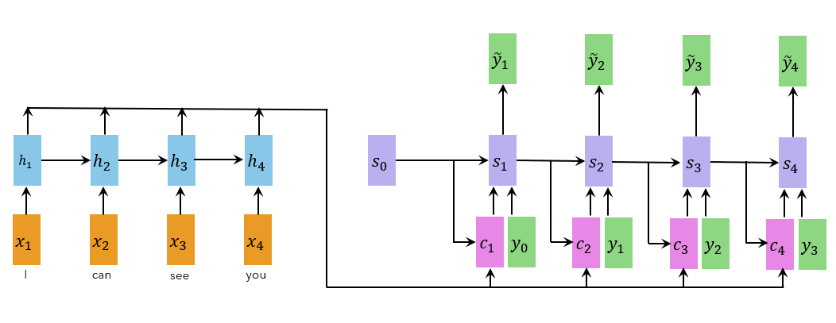
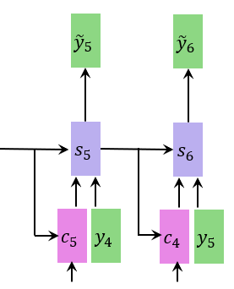
NLP Tasks with Attention Layer
CROSS
_________ ATTENTION LAYER
मैं आपको देख सकता हूं
<EOS>
<START>
मैं आपको देख सकता हूं
Many to Many: Machine Translation

Slide 33
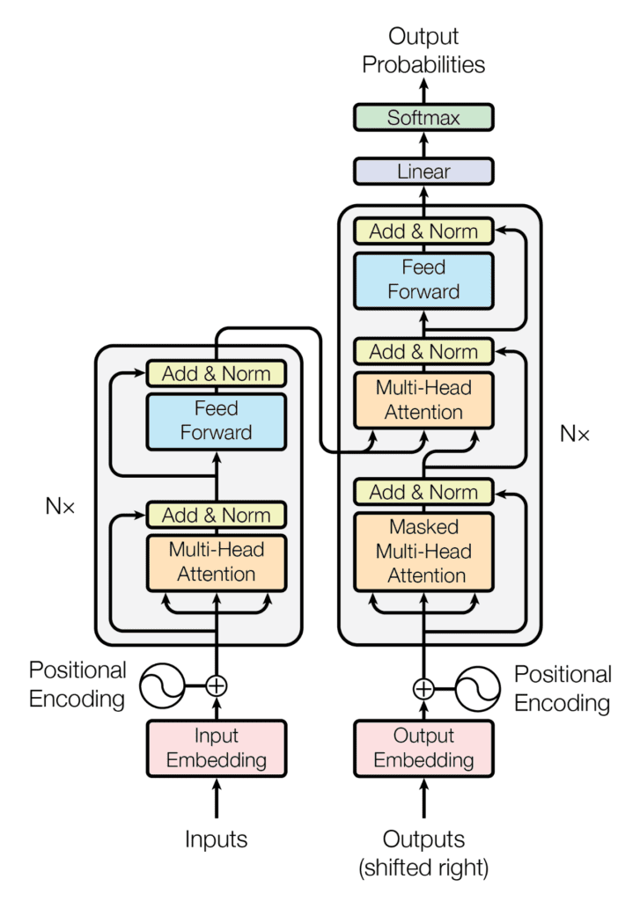
The Major Application
Transformer
Next Lecture

Slide 34
Summary
RNN bottlenecks and does not perform relative activations
Attention in the rescue
Attention layer added on top of RNN
Attention can be implemented via matrices (Query, Key, Value)
Different types of attention mechanisms
Self attention (encoder or decoder)
Cross attention (encoder-decoder)
Masked attention (ignoring certain part of input)
Multi-head attention (stack of attention layers)
Attention All You Need!! (Transformers)

Slide 35
Resources
Neural Machine Translation by Jointly Learning to Align and Translate
Dzmitry Bahdanau, Kyunghyun Cho, Yoshua Bengio
https://arxiv.org/abs/1409.0473
I acknowledge sources from which the images have been picked up

