Slide 1
Introduction
Plaban Kumar Bhowmick
Department of AI
plaban@ai.iitkgp.ac.in

Slide 2
Evolution of Language Processing
Pattern Matching
Rule-based NLP
HMM
Probabilistic LM
Statistical NLP
Feature Extraction
CRF
Linguistic Rules
RNN
Task Specific
Self-Attention
CNN
Deep NLP
Transformers
GRU
Supervised
Task Specific
Prompt Engineering
Word2vec
LSTM
BERT
GPT
Pre-Training → Fine Tuning
Foundation Models
PT once, FT multiple times
GPT-X
Llama

Slide 3
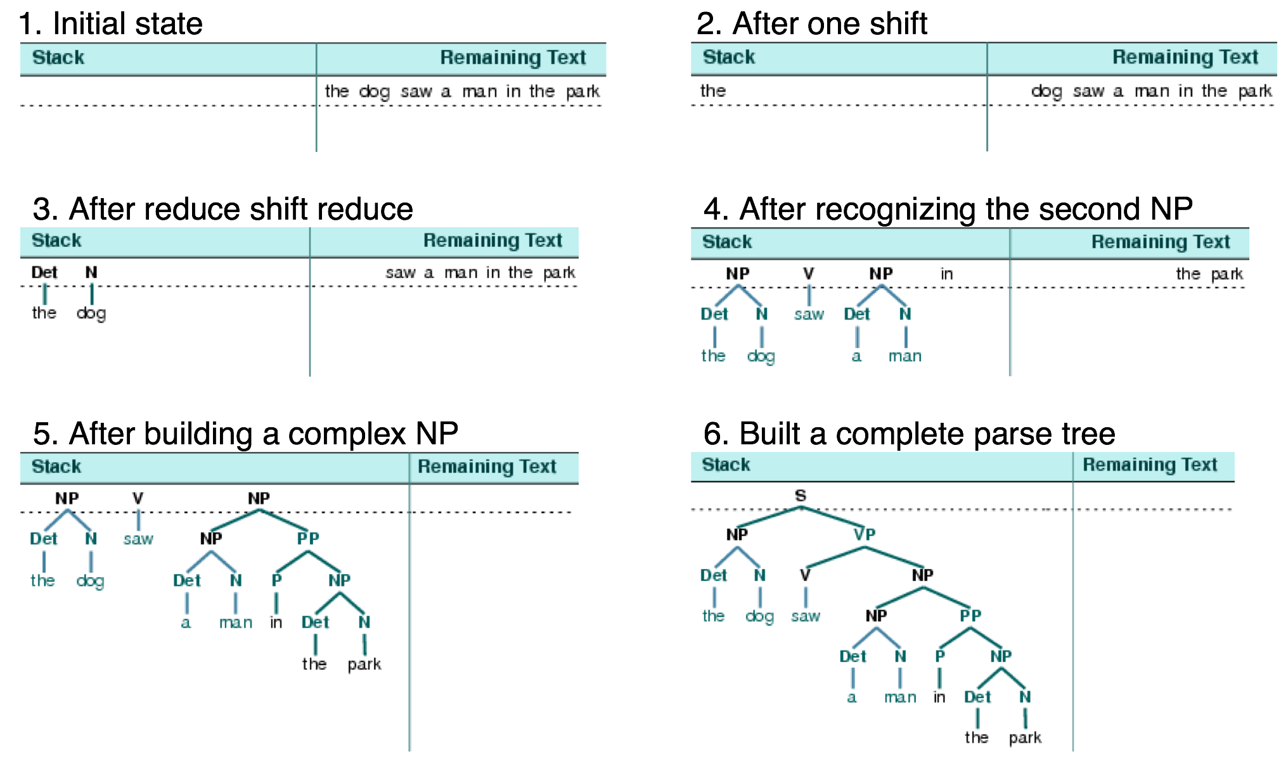
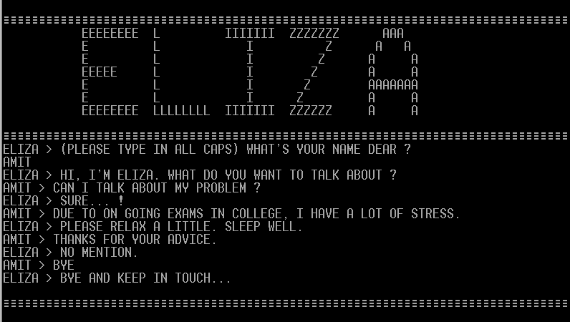
Rule-based NLP

Slide 4
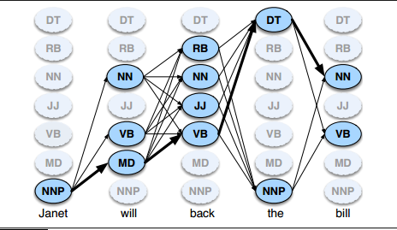
Statistical NLP
Language is a sequential data!!
Predict the next word given last few words have been seen
Probabilistic Language Model
$$w_{1}, w_{2}, …,w_{k−1}$$
$$w_{k}$$
Manual feature engineering
$$P(w_{k}|w_{1}, w_{2}, …,w_{k−1})$$
Sparse Representation
Classify the current word given the annotation of the prev. tokens

Slide 5
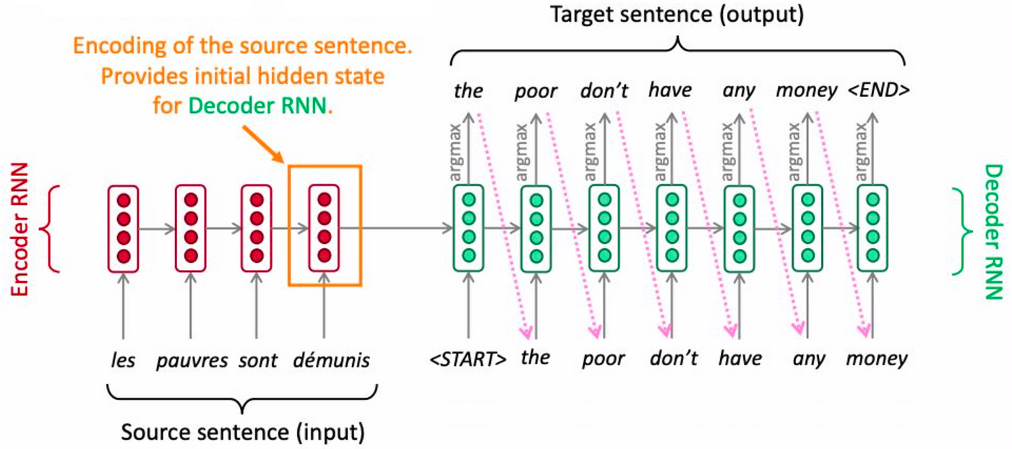
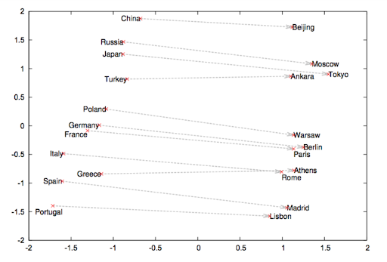
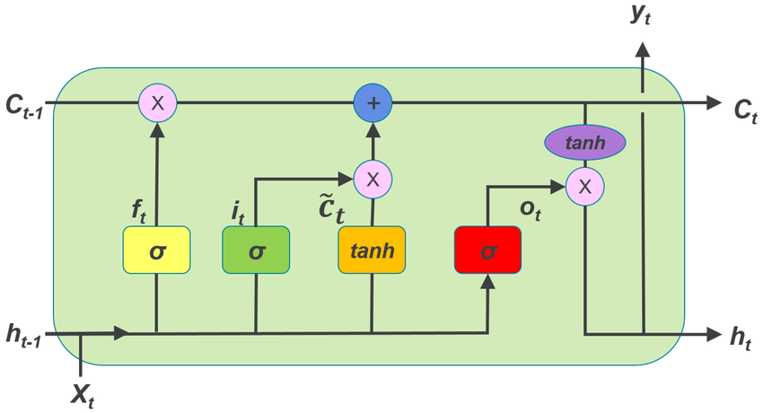
Deep NLP
Neural Language Models
Context independent representation
Bottleneck architecture leading to lack of
long distance interaction

Slide 6
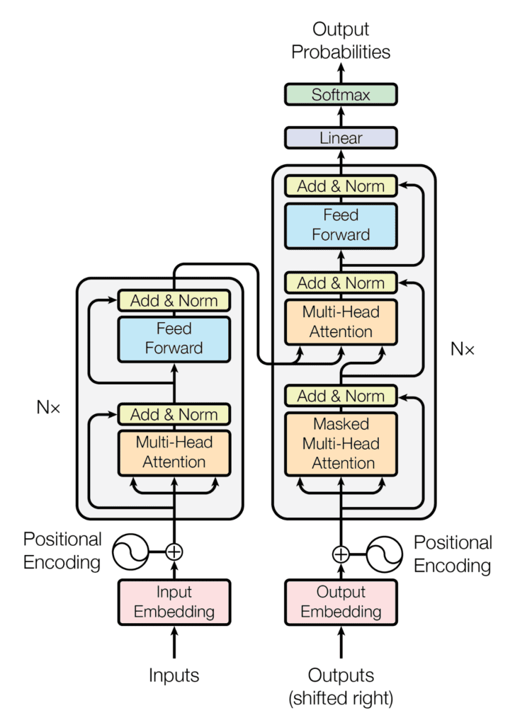
Transformer Moment in NLP
Self Attention
Multihead Attention
Masked Attention

Slide 7
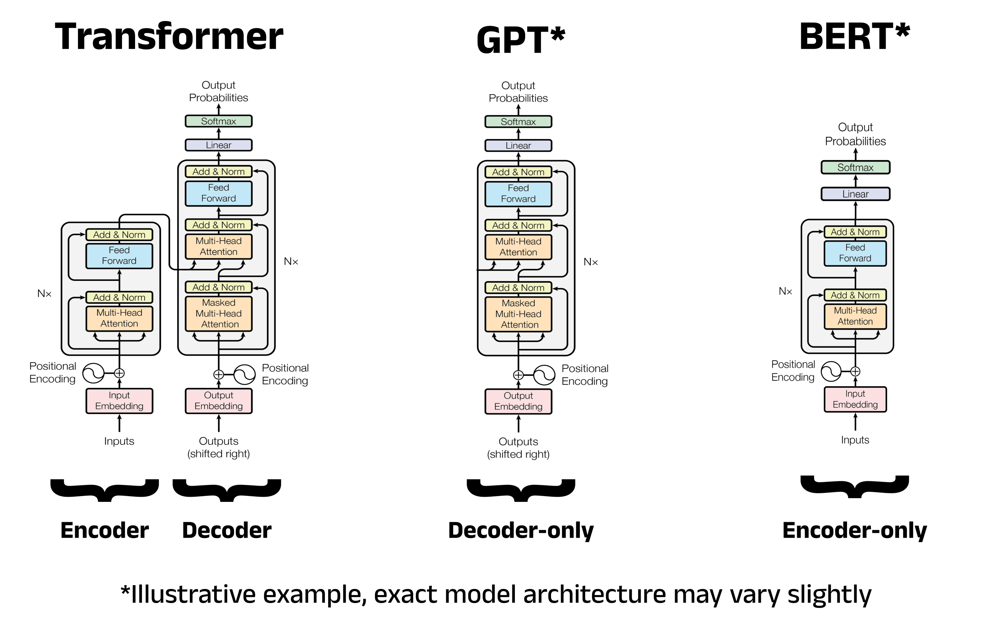
Pre-Training Once Fine Tune Multiple Times

Slide 8
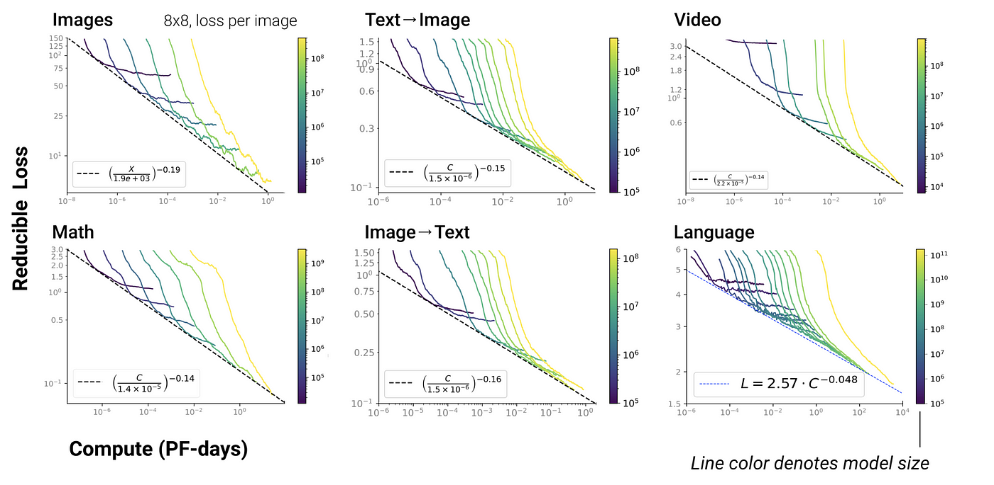
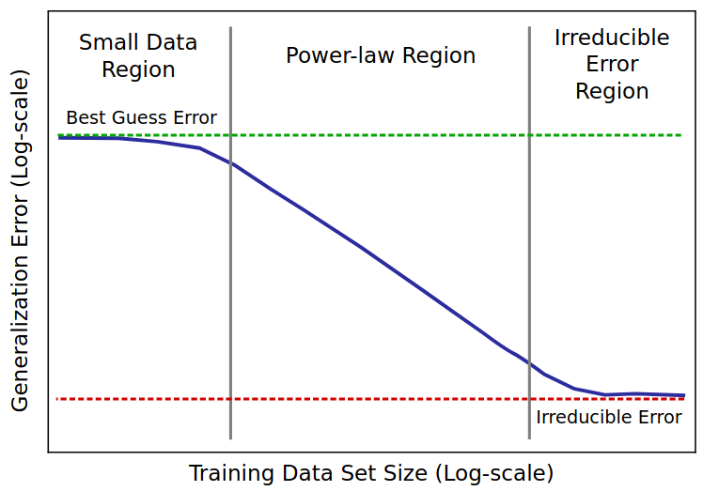
“Emergence” with Scale
The loss reduces with feeding more and more training data
The loss reduces with feeding more and more compute
Ability to solve tasks without training specifically for it

Slide 9
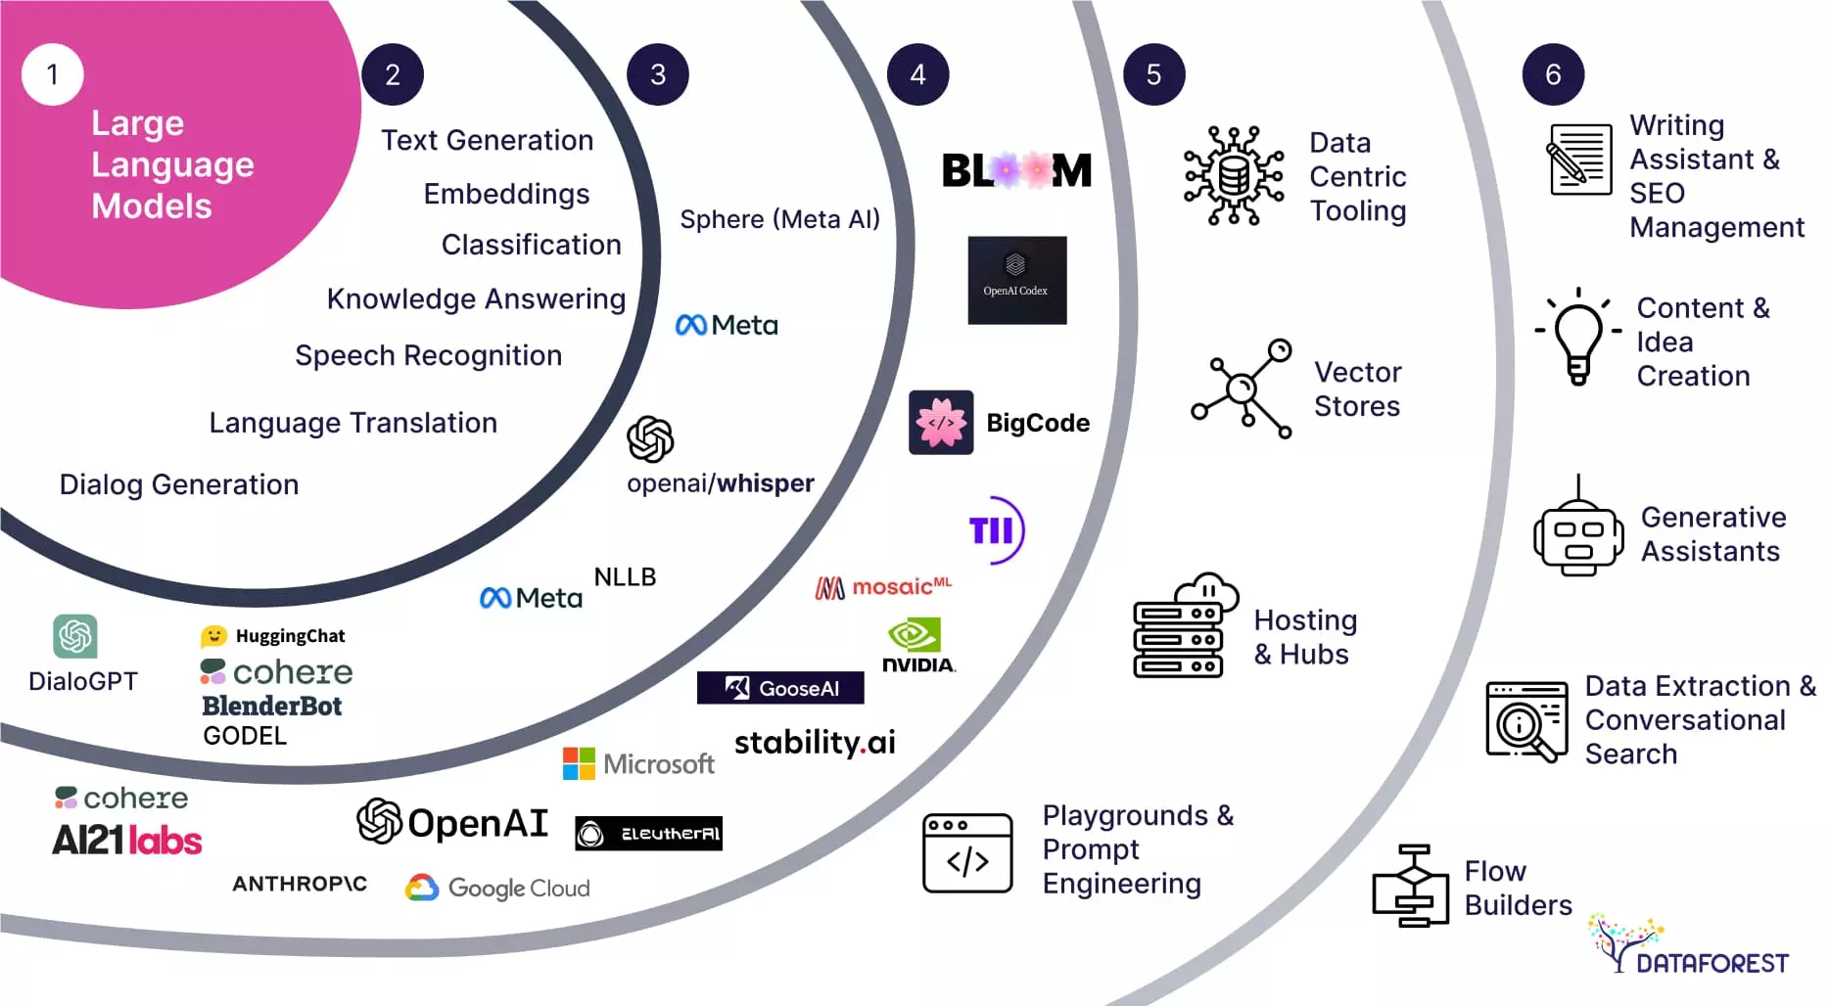
Age of LLMs

Slide 10
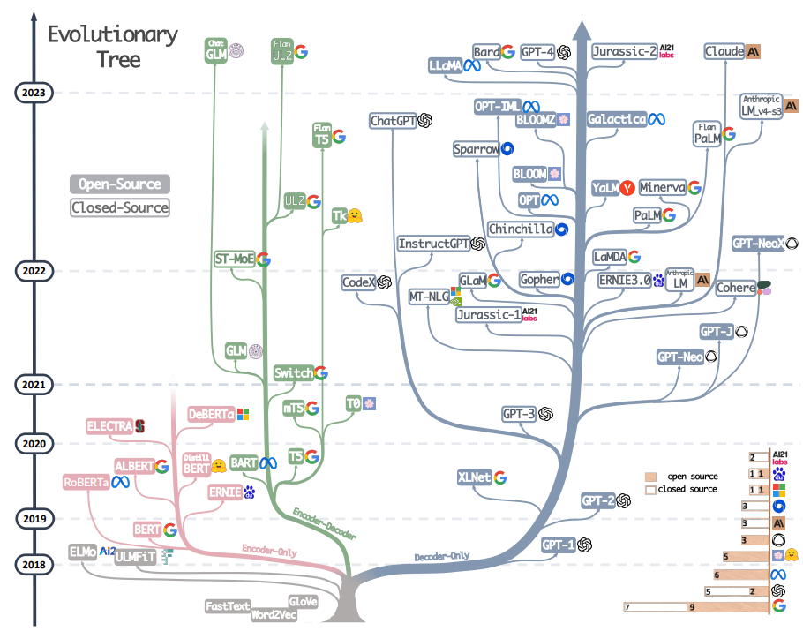
Age of LLMs

Slide 11
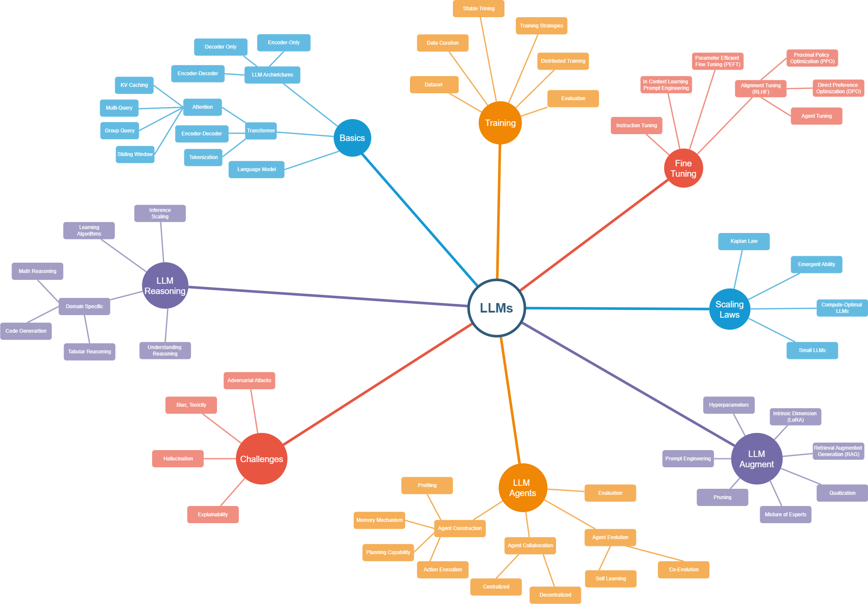
LLM Concept Map

Slide 12
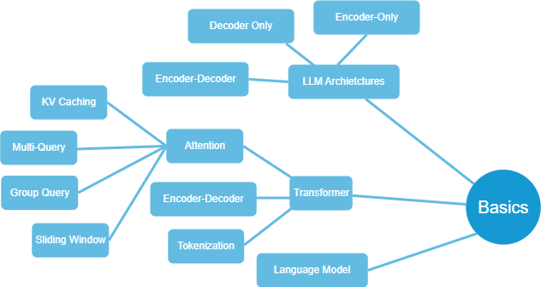
Foundation
How do we model natural language?
Transformer: Foundation of LLM architectures
Why do we need Transformers?
What are the building blocks of Transformers?
Attention mechanism as the central idea
Efficient implementation of attention
Different kinds of LLM architectures

Slide 13
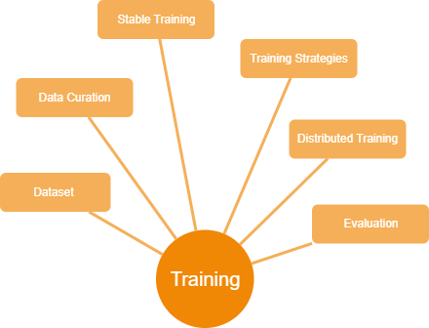
(Pre-) Training LLMs
What would be training strategy?
Where would the training data come from?
How do we know whether the training is successful?
Can we make design efficient training mechanism?

Slide 14
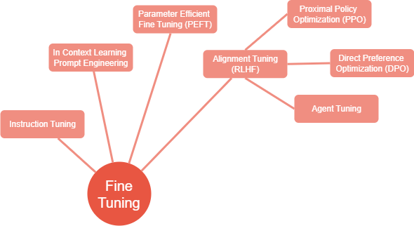
Fine Tuning
Can we fine tune the LLM parameters to
perform certain tasks?
Can we instruct an LLM to perform certain
type of tasks?
Can we instruct an LLM with some examples?
Can we make an LLM aware of the task
situation?
Can we align the LLMs to follow some
expected behaviors?

Slide 15
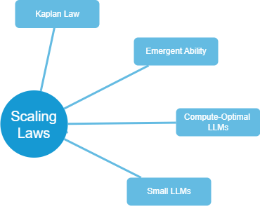
Scaling Laws
Are larger models better generators?
Does scaling up the dataset lead to better LLMs?
Does scaling up the compute lead to better LLMs?
Do the scaling strategies follow any trend?
Does scaling lead to ‘emergent’ behavior?
Is ‘emergent’ behavior real?
Can we design small LLMs that are compute optimal?

Slide 16
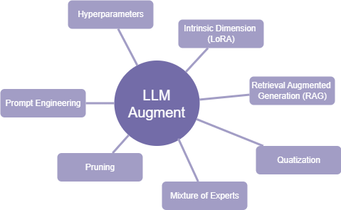
Augmenting LLMs
What are the hyperparameter and how to tune?
What are the different ways to prompt LLMs?
Can we fine tune the parameters considering
intrinsic dimensions of the embedding?
Can we lower precision?
Can we retrieve external knowledge and add to
the context during generation?
Can we design a committee of experts each focusing
on particular aspects of the input problem?

Slide 17
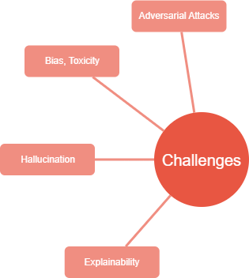
Challenges in LLMs
Can LLMs be attacked to output incorrect predictions?
Can LLMs generate ‘coherent’ but incorrect information?
Can LLMs generate toxic, biased or harmful content?
Can LLMs explain the predictions?

Slide 18
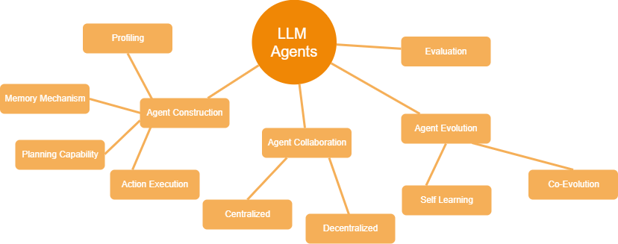
LLM Agents
What can be a generic architecture of automated agent?
How do we evaluate automated agents?
Can agents evolve to solve task in a dynamic and unknown environment?
Can agents perform complex tasks through collaboration?

Slide 19
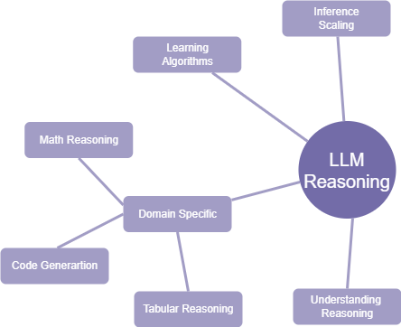
LLM Reasoning Capability

Slide 20
My View of LLMs
LLMs are huge computing systems that only generate
tokens (probabilistically) given a context and thrives on
certain heuristics for its configuration
generate a picture Tom chasing Jerry with wearing kurta and turban while Jerry wearing lungi
LLMs are parameterized memory

Slide 21
What to Expect?
LLMs are remarkable engineering achievement
BUT
Lacks theoretical understanding
We will focus on the engineering aspect of LLMs
ignoring
Theoretical understanding and rigor

Slide 22
Course Logistics
Written Exams
Midsem (25)+Endsem (35)
Assignment (20)
3 assignments (7+7+6)
Project (10)
Paper Reading on Reasoning models (10)
Conceptualization + Visualization + Code explanation

